Slide 1
Chapter 0
Introduction
Nguyen Thuy Huong

Slide 2
Objectives
Introduction
Why .NET framework?
Learning by doing
Contents and Schedule
Resource

Slide 3
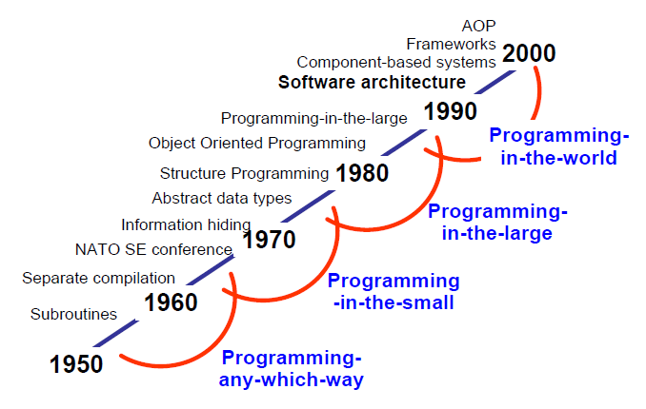
Evolution of Software Design
Notes:
AOP: Aspect-Oriented Programming: Lập trình hướng vấn đề
Tendency: The system become larger and more complex
From 1950 – 1960: Program is included of subroutines, each subroutine only does single function
End of 1960s: The first time the term SE is adopted in the NATO SE conference => to solve the problem “Software crisis” (Project cancel, delay, not enough people…) => need a new approach, methodology, technology…
From 1970 – 1980: Information hiding, Structure Programming (data separated from functions => if data is changed => all related functions must be change too => can’t reuse)
From 1980 – 1990: Object oriented programming: data and functions (method, behavior is encapsulated) => reuse
From 1990 – 2000: Software architecture – the first time this subject is taught in universities, the system based on components, Framworks

Slide 4
.NET Framework value
Microsoft has created a whole new platform for development.
This platform overcomes many of the problems:
  Long development times
  Inability to change applications quickly
  High total cost of ownership of software
  Difficult to deployment.

Slide 5
The .NET and Return on investment (ROI)
ROI = Total benefit/Total cost of development
.NET help ROI: Less time to develop application (much re-useable code and so many re-useable components)
  Scalability (can scale and support the additional load)
  Maintainability (configuration settings that can be modified without having to re-write code)
  Deployment (different versions of the same DLL)
  Reliability (built-in checks and balances)
  Security
  Cross Platform (desktop, browser, mobile browser, PDA)
  Services-Oriented Architecture
Notes:
Personal digital assistant (PDA), also known as a handheld PC

Slide 6
Learning by doing - 1
There is really no learning without doing.
There maybe appearance of learning by memorizing things and be able to passing tests but there is minimum retention afterward.
Students build their knowledge by actually trying things out and improve their skills by learning what works and what does not work.
Learning and retention rate are the key factor in the “Learning by Doing” method. Research has shown that students will only retain their knowledge about:

Slide 7
Learning by doing - 2
  5% if it focus only on lecturing
  10% if it is focusing on reading
  20% if the focus is on audiovisual and demonstration
  50% by group discussions
  75% by actual practicing
  90% by actual teach others.

Slide 8
Learning by doing - 3
Students will be asked to go over reading and practice for the week, before coming to class. They must complete the weekly homeworks before class to demonstrate that they have read all reading assignments and have some knowledge of the materials. (This will help that they could retain 20% of the knowledge).
In class, students will spent more time on class discussion on certain topic and perform team works where they actually implement what they learned in class based on team scenarios (This will help improve their knowledge and skills via practicing and improve retention rate to 80%)

Slide 9
Learning by doing - 3
As students learn the subject, they will be asked to actually lead the discussion and teach the subject to their classmates (That will help build their knowledge, skills and retention rate to over 90%)

Slide 10
Contents
Part 1: Introduction
Part 2: C# language
Part 3: Programming with .NET assemblies
Part 4: Programming with .NET libraries
Part 5: Web applications and Web services

Slide 11
Schedule - 1
  Week 1:
  Philosophy of .NET (ch.1), Building application (ch. 2)
  C# Language fundamentals (ch. 3)
  OOP with C# 2.0 (ch. 4),
  Structured exception handling (ch.6)
  Guiding Lab 1

Slide 12
Schedule - 2
Week 2: submit Lab 1
  Interfaces and collections (ch. 7),
  Generics (ch. 10)
  Callback interfaces, delegates, and events (ch. 8)

Slide 13
Schedule - 3
Week 3:
  .NET assemblies (ch. 11)
  Multithreaded applications (ch. 14)
  System IO namespaces (ch. 16)
  Guiding Lab 2

Slide 14
Schedule - 5
Week 4: submit Lab2
  Windows Forms (ch. 19)
  Windows Forms Controls (ch. 21)
  Database Access with ADO.NET (ch. 22)

Slide 15
Schedule - 6
Week 5:
  Database Access with ADO.NET (ch. 22)
  Guiding Lab 3
  Week 6: submit Lab 3
  PT1
Week 7:
  Web pages and controls (ch. 23)
  Web applications (ch. 24)
  XML Web services (ch 25)
  Project presentations
  Progress test 2 (7.5%)
Week 7: Final Exam (30%)

Slide 16
Schedule - 6
Week 8: Submit Lab 4
  Guiding Lab 4 and Project
Week 9:
  Review
  PT2
  PE
  Week 10:
  Project presentations

Slide 17
Complete criteria
4 Labs: 15% > 0
2 PT: 15% > 0
Team Project: 20% > 0
Practical exam: 20% >= 0
Final exam: 30% >= 4
  Final result >= 5

Slide 18
Resources
Tools
  Visual studio 2017
  SQL server 2008
Text books
  Apress.Pro.C.Sharp.with..NET.3.0.Special.Edition.Jan.2007
  Beginning C# ObjectOriented (for doing Project)

Slide 19
Q & A

